Slide 1
Object Oriented Method && C++ Program Design
Programming
Principles and Practice Using C++
Lecture 8 – Templates
Shengfa Wang

Slide 2

Templates
This chapter introduces templates, which are a C++ feature that easily permits the reuse of existing code for new purposes.
By using templates we write a single code for a set of related functions- called function template and related classes- called class template.
Notes:
Templates are an important part of C++ that allows a programmer to reuse existing code for new purposes. In some sense, templates ensure that you don’t have to continually “reinvent the wheel.”
This lecture introduces how to implement and use template functions.

Slide 3
Function Templates
In the dictionary: a template is a model that serves as a pattern for creating similar objects.
In C++, function templates are functions that serve as a pattern for creating other similar functions.
The basic idea behind function templates is to create a function without having to specify the exact type(s) of some or all of the variables. Instead, we define the function using placeholder types, called template type parameters.

Slide 4
Finding the Maximum of Two Integers
Here’s a small function that you might write to find the maximum of two integers.
int maximum(int a, int b)
{
if (a > b)
return a;
else
return b;
}
Notes:
To illustrate template functions, let’s look at this simple function. It would appear as part of a program that needs to find the larger of two integers. The function returns a copy of the larger of its two arguments.

Slide 5
Finding the Maximum of Two Doubles
Here’s a small function that you might write to find the maximum of two double numbers.
int maximum(double a, double b)
{
if (a > b)
return a;
else
return b;
}
Notes:
Suppose your program also needs to find the larger of two double numbers. Then you could add a second function for double numbers. By the way, you may use the same name, maximum, for the two functions. The compiler is smart enough to determine which function your program is using at any given point, by looking at the types of the parameters.

Slide 6
Finding the Maximum of Two Knafns
Here’s a small function that you might write to find the maximum of two knafns.
int maximum(knafn a, knafn b)
{
if (a > b)
return a;
else
return b;
}
Notes:
Suppose your program also has another data type, called knafn. This could be a class that you wrote yourself for some purpose.
Anyway, perhaps knafn objects can be compared with the > operation (because the knafn implementation includes an overloaded > operator). In this case, your program might have a third function to compare two knafn objects.

Slide 7
One Hundred Million Functions...
Suppose your program uses 100,000,000 different data types, and you need a maximum function for each...
int maximum(Hoo a, Hoo b)
{
if (a > b)
return a;
else
return b;
}
int maximum(Hoo a, Hoo b)
{
if (a > b)
return a;
else
return b;
}
int maximum(Hoo a, Hoo b)
{
if (a > b)
return a;
else
return b;
}
int maximum(Noo a, Noo b)
{
if (a > b)
return a;
else
return b;
}
int maximum(Moo a, Moo b)
{
if (a > b)
return a;
else
return b;
}
int maximum(Doo a, Doo b)
{
if (a > b)
return a;
else
return b;
}
int maximum(Moo a, Moo b)
{
if (a > b)
return a;
else
return b;
}
int maximum(Doo a, Doo b)
{
if (a > b)
return a;
else
return b;
}
int maximum(Noo a, Noo b)
{
if (a > b)
return a;
else
return b;
}
int maximum(Moo a, Moo b)
{
if (a > b)
return a;
else
return b;
}
int maximum(Doo a, Doo b)
{
if (a > b)
return a;
else
return b;
}
int maximum(Noo a, Noo b)
{
if (a > b)
return a;
else
return b;
}
int maximum(Foo a, Foo b)
{
if (a > b)
return a;
else
return b;
}
int maximum(Foo a, Foo b)
{
if (a > b)
return a;
else
return b;
}
int maximum(Foo a, Foo b)
{
if (a > b)
return a;
else
return b;
}
int maximum(Poo a, Poo b)
{
if (a > b)
return a;
else
return b;
}
int maximum(Boo a, Boo b)
{
if (a > b)
return a;
else
return b;
}
int maximum(Poo a, Poo b)
{
if (a > b)
return a;
else
return b;
}
int maximum(Koo a, Koo b)
{
if (a > b)
return a;
else
return b;
}
int maximum(Poo a, Poo b)
{
if (a > b)
return a;
else
return b;
}
int maximum(Boo a, Boo b)
{
if (a > b)
return a;
else
return b;
}
int maximum(Boo a, Boo b)
{
if (a > b)
return a;
else
return b;
}
int maximum(Joo a, Joo b)
{
if (a > b)
return a;
else
return b;
}
int maximum(Koo a, Koo b)
{
if (a > b)
return a;
else
return b;
}
int maximum(Koo a, Koo b)
{
if (a > b)
return a;
else
return b;
}
int maximum(Knafn a, Knafn b)
{
if (a > b)
return a;
else
return b;
}
int maximum(Ioo a, Ioo b)
{
if (a > b)
return a;
else
return b;
}
int maximum(Joo a, Joo b)
{
if (a > b)
return a;
else
return b;
}
int maximum(Joo a, Joo b)
{
if (a > b)
return a;
else
return b;
}
int maximum(Knafn a, Knafn b)
{
if (a > b)
return a;
else
return b;
}
int maximum(Ioo a, Ioo b)
{
if (a > b)
return a;
else
return b;
}
int maximum(Knafn a, Knafn b)
{
if (a > b)
return a;
else
return b;
}
int maximum(Ioo a, Ioo b)
{
if (a > b)
return a;
else
return b;
}
int maximum(Coo a, Coo b)
{
if (a > b)
return a;
else
return b;
}
int maximum(Coo a, Coo b)
{
if (a > b)
return a;
else
return b;
}
int maximum(Coo a, Coo b)
{
if (a > b)
return a;
else
return b;
}
int maximum(Loo a, Loo b)
{
if (a > b)
return a;
else
return b;
}
int maximum(Goo a, Goo b)
{
if (a > b)
return a;
else
return b;
}
int maximum(Goo a, Goo b)
{
if (a > b)
return a;
else
return b;
}
int maximum(Loo a, Loo b)
{
if (a > b)
return a;
else
return b;
}
int maximum(Goo a, Goo b)
{
if (a > b)
return a;
else
return b;
}
int maximum(Loo a, Loo b)
{
if (a > b)
return a;
else
return b;
}
Notes:
In fact, for your next programming assignment, I’m going to give you a printed list of 100,000,000 different data types, each of which has the > operator defined. Your job will be to implement a maximum function for each of the types. How long do you think this job will take?
How many of you think it will take more than one day’s work? Raise your hands.
Okay, now how many of you think you’ll need less than a day--in fact less than five minutes? Raise your hands. These are the people that have been reading ahead in Chapter 6 about a feature called template functions.

Slide 8
Function Templates
The syntax for function templates is:
template <class Type>
declaration;
where Type is the type of the data and declaration is either a function declaration or a class declaration.
  In C++, template is a reserved word.
  The word class in the heading refers to any user-defined type or built in type.
  Type is referred as a formal parameter to the template.
  Just as variables are parameters to functions, types (that is, data types) are parameters to templates.

Slide 9
A Template Function for Maximum
This template function can be used with many data types.
template <class Item>
Item maximum(Item a, Item b)
{
if (a > b)
return a;
else
return b;
}
Notes:
This is our first example of a template function. It is a single function that depends on an underlying data type that I’ve called Item. The actual Item type could be any of many different types: int, double, char--in fact any type that has two features: (1) the data values can be compared with the > operator, and (2) the data type has a copy constructor. (By the way, where is the copy constructor needed? It is needed to initialized the two parameters from their actual arguments, and also needed when the function returns a value.)
Anyway, let’s look at the pattern for converting an ordinary function to a template function...

Slide 10
A Template Function for Maximum
When you write a template function, you choose a data type for the function to depend upon...
template <class Item>
Item maximum(Item a, Item b)
{
if (a > b)
return a;
else
return b;
}
Notes:
Our maximum function depends on the type of the item that we are comparing. This is the type of the two parameters, and also the return type. So, in the template function, we choose a name for this type--we use the name Item--and you use that name instead of the actual data type name.

Slide 11
A Template Function for Maximum
A template prefix is also needed immediately before the function’s implementation:
template <class Item>
Item maximum(Item a, Item b)
{
if (a > b)
return a;
else
return b;
}
Notes:
Before an implementation, a special template prefix is also require. The prefix consists of the keyword template followed by angle brackets. Inside the angle brackets is the keyword class and the name that you choose to describe the underlying data type.

Slide 12
Using a Template Function
Once a template function is defined, it may be used with any adequate data type in your program...
template <class Item>
Item maximum(Item a, Item b)
{
if (a > b)
return a;
else
return b;
}
cout << maximum(1,2);
cout << maximum(1.3, 0.9);
...
Notes:
Here are two examples of how the single template function can be used in two different ways in a program. In the first example, the compiler sees two integer arguments, so the compiler will automatically create a version of the function where the Item is an int. In the second example, the compiler sees two double arguments, so the compiler will automatically create a version of the function where the Item is a double. We could have a third example where the two arguments were Knafn objects, and the compiler would automatically create a version of the function where the Item is a Knafn.

Slide 13
Finding the Maximum Item in an Array
Here’s another function that can be made more general by changing it to a template function:
int array_max(int data[ ], size_t n)
{
size_t i;
int answer;
assert(n > 0);
answer = data[0];
for (i = 1; i < n; i++)
if (data[i] > answer) answer = data[i];
return answer;
}
Notes:
Here’s another function that can be improved by making it into a template function. In this form, the function can find the largest integer in an array of integers. But it can’t be used for an array of double numbers, or an array of some other kind of objects.
In this case, the function depends on the underlying data type of the components of the array. We can call this component type Item, and rewrite the function as a template function...

Slide 14
Finding the Maximum Item in an Array
Here’s the template function:
Notice these things:
the template prefix
2. The change of the data type of at least one parameter (the array)
3. The change of the return type (this might not occur for every template function)
4. In the implementation, we can use the Item type for local variables
template <class Item>
Item array_max(Item data[ ], size_t n)
{
size_t i;
Item answer;
assert(n > 0);
answer = data[0];
for (i = 1; i < n; i++)
if (data[i] > answer) answer = data[i];
return answer;
}
Notes:
Here’s the template version. Notice these things:
1. the template prefix
2. The change of the data type of at least one parameter (the array)
3. The change of the return type (this might not occur for every template function)
4. In the implementation, we can use the Item type for local variables

Slide 15
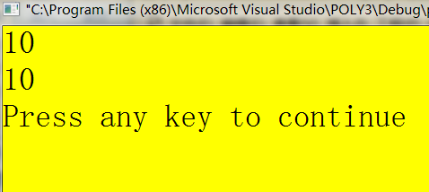
Example (1)
#include<iostream>
using namespace std;
template <typename T>
T add(T a, T b)
{
return a+b;
}
int main(){
int z=add(4,6);
double zz=add(3.5,6.5);
cout<<z<<"\n"<<zz<<endl;
}

Slide 16
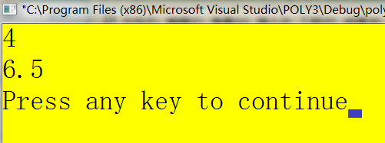
Example (2)
#include<iostream>
using namespace std;
template <class T>
T min(T a, T b){
return a<b?a:b;
}
int main(){
int z=min(4,6);
double zz=min(9.45,6.5);
cout<<z<<"\n"<<zz<<endl;
}

Slide 17
Class in place of typename
There are two syntaxes for a template function, they are both exactly the same and interchangeable:
template <typename Type>
template<class Type>

Slide 18
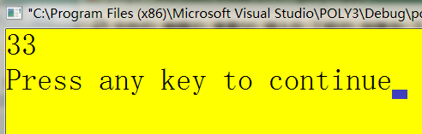
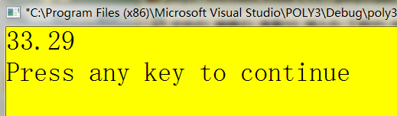
min(x, y)
Example (3)
#include<iostream>
using namespace std;
template <class T1,class T2>
T1 min(T1 a, T2 b){
return a<b?a:b;
}
int main(){
int x=56;
double y=33.29;
cout<< <<endl;
}
min(y, x)

Slide 19
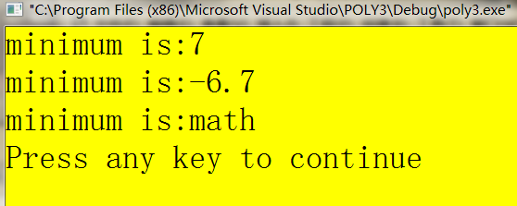
Example (4)
#include<iostream>
#include<string>
using namespace std;
template <class T>
T min(T a, T b){
return a<b?a:b;
}
int main(){
int i=42;
cout<<"minimum is:"<<min(7,i)<<endl;
double f1=3.4, f2=-6.7;
cout<<"minimum is:"<<min(f1,f2)<<endl;
string s1="mathmatics", s2="math";
cout<<"minimum is:"<<min(s1,s2)<<endl;
}

Slide 20
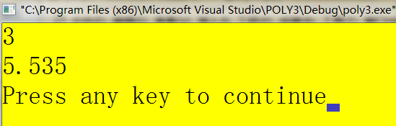
#include<iostream>
using namespace std;
template <class T>
T Average(T *atArray, int nNumValues) {
T tSum = 0;
for (int nCount=0; nCount < nNumValues; nCount++)
tSum += atArray[nCount];
tSum /= nNumValues;
return tSum;}
int main(){
int anArray[] = { 5, 3, 2, 1, 4 };
cout << Average(anArray, 5) << endl;
double dnArray[] = { 3.12, 3.45, 9.23, 6.34 };
cout << Average(dnArray, 4) << endl;
return 0;
}

Slide 21
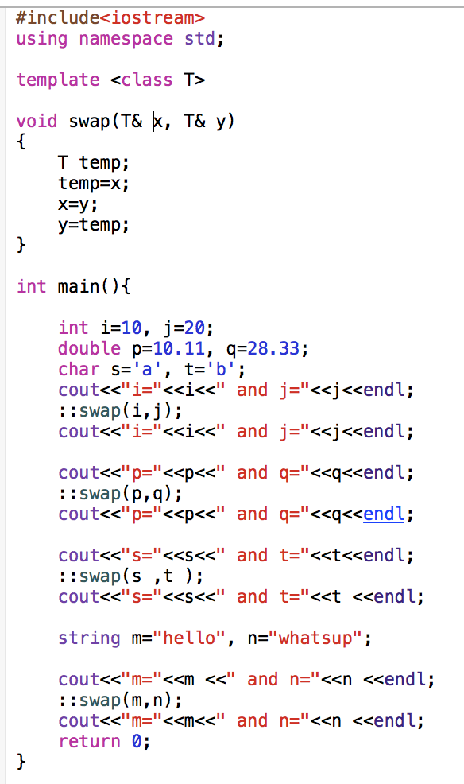
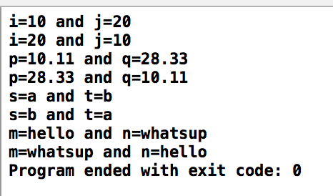

Slide 22
Bubble sort
Bubble sort is a simple and well-known sorting algorithm.
Algorithm
Compare each pair of adjacent elements from the beginning of an array and, if they are in reversed order, swap them.
If at least one swap has been done, repeat step 1.

Slide 23
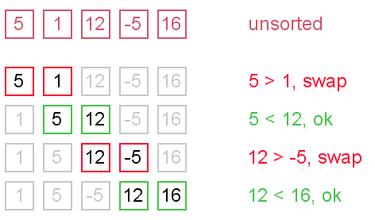
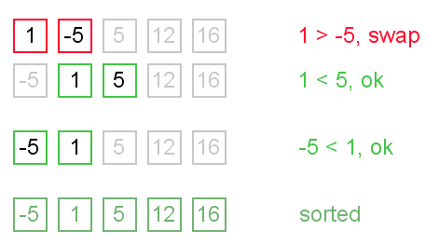
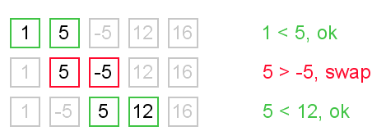
Con’t

Slide 24
Bubble Sort
#include <iostream>
using namespace std;
template <class T >
void bubble(T *items,int count) {
T t;
for(int a=1; a<count; a++)
for(int b=count-1; b>=a; b--)
if(items[b-1] > items[b]) {
t = items[b-1];
items[b-1] = items[b];
items[b] = t;
}
}
Notes:
void bubble_sort(T arr[], int len)
{
int i, j; T temp;
for (i = 0; i < len - 1; i++)
for (j = 0; j < len - 1 - i; j++)
if (arr[j] > arr[j + 1])
{
temp = arr[j];
arr[j] = arr[j + 1];
arr[j + 1] = temp;
}
}

Slide 25
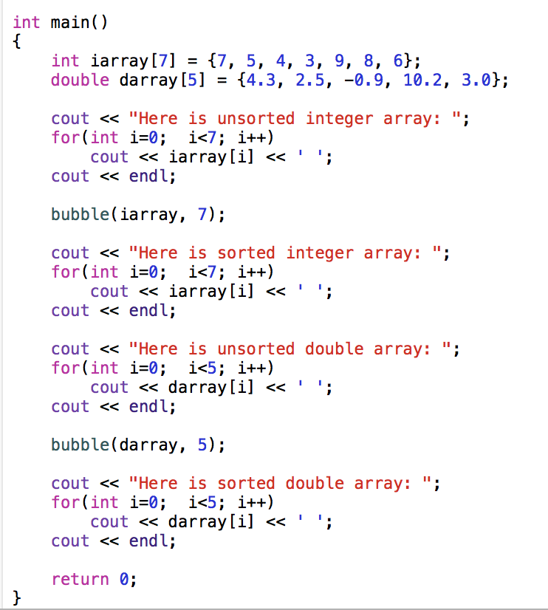

Slide 26
Summary of Three Approaches
Naive Approach
Different Function Definitions
Different Function Names
Function Overloading
Different Function Definitions
Same Function Name
Template Functions
One Function Definition (a function template)
Compiler Generates Individual Functions

Slide 27
Class template
So far the classes that we define use fix data types.
Sometime is useful to allow storage in a class for different data types.
What if we want to make a simple list of double type?
    Copy paste the whole file and replace int with double
    Make use of typedef in C++

Slide 28
Class template
  Function templates allow writing generic functions that work on many types.
  Same idea applies to defining generic classes that work with many types -- extract the type to be a template to make a generic classes.
  A C++ language construct that allows the compiler to generate multiple versions of a class by allowing parameterized data types.

Slide 29
Class template
To make a class into a template, prefix the class definition with the syntax:
template< class T >
  Here T is just a type parameter. Like a function parameter, it is a place holder.
  When the class is instantiated, T is replaced by a real type.
To access a member function, use the following syntax:
  className< T >:: memberName.
Using the class template for instantiation:
  ClassName<real type> variable;

Slide 30
Example of a Class Template
template<class ItemType>
class GList
{
public:
bool IsEmpty() const;
bool IsFull() const;
int Length() const;
void Insert( /* in */ ItemType item );
void Delete( /* in */ ItemType item );
bool IsPresent( /* in */ ItemType item ) const;
void SelSort();
void Print() const;
GList(); // Constructor
private:
int length;
ItemType data[MAX_LENGTH];
};
Template parameter
Notes:
Template <class ItemType> says that ItemType is a type name, it need not be the name of a class.
The scope of ItemType extends to the end of the declaration prefixed by template <class ItemType>

Slide 31
Instantiating a Class Template
Class template arguments must be explicit.
The compiler generates distinct class types called template classes or generated classes.
When instantiating a template, a compiler substitutes the template argument for the template parameter throughout the class template.
Notes:
The process of generating a class declaration from a template class and a template argument is often called template instantiation. Similarly, a function is generated (“instantiated”) from a template function plus a template argument. A version of a template for a particular template argument is called a specialization.

Slide 32
Instantiating a Class Template
To create lists of different data types
// Client code
GList<int> list1;
GList<float> list2;
GList<string> list3;
list1.Insert(356);
list2.Insert(84.375);
list3.Insert("Muffler bolt");
template argument
Notes:
The name of a class template followed by a type bracketed by <> is the name of a class (as defined by the template) and can be used exactly like other class names.

Slide 33
Substitution Example
class GList_int
{
public:
void Insert( /* in */ ItemType item );
void Delete( /* in */ ItemType item );
bool IsPresent( /* in */ ItemType item ) const;
private:
int length;
ItemType data[MAX_LENGTH];
};
int
int
int
int

Slide 34
Function Definitions for Members Template Class
template<class ItemType>
void GList<ItemType>::Insert( /* in */ ItemType item )
{
data[length] = item;
length++;
}
//after substitution of float
void GList<float>::Insert( /* in */ float item )
{
data[length] = item;
length++;
}

Slide 35
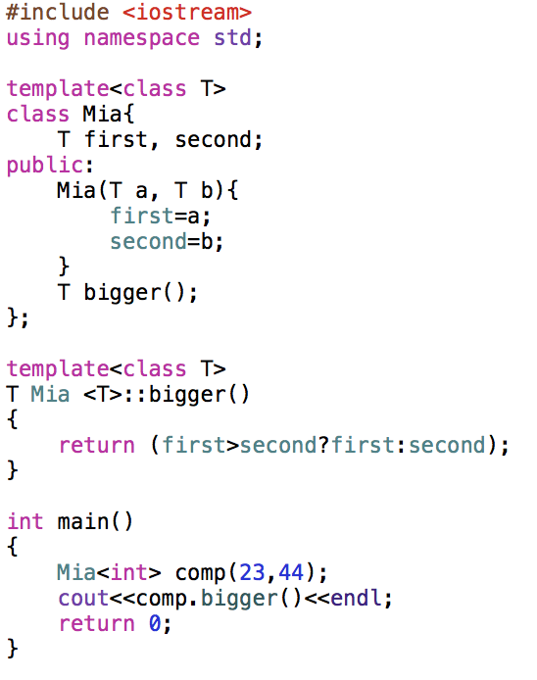
Define member function out of the class
Class instantiation must specify specific date type

Slide 36
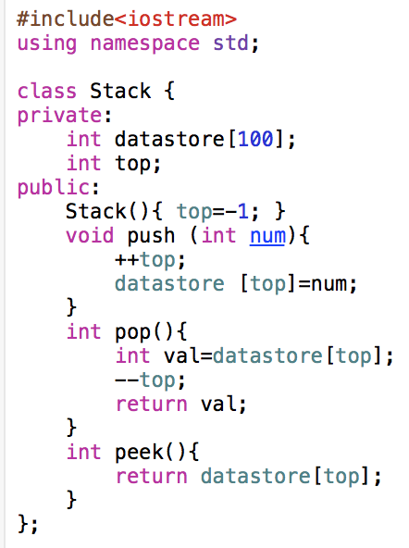
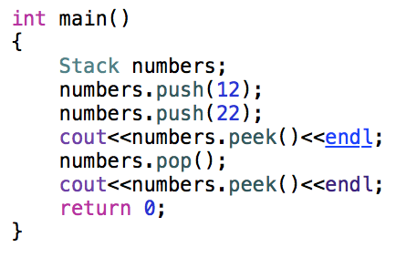


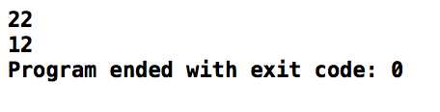
Class Templates

Slide 37
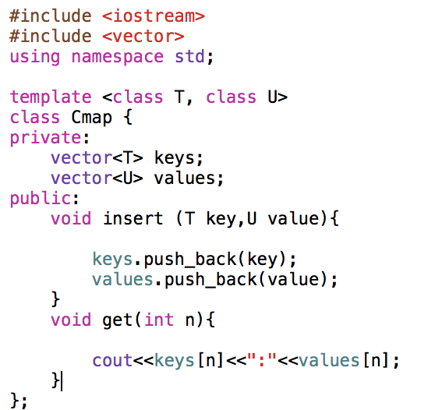
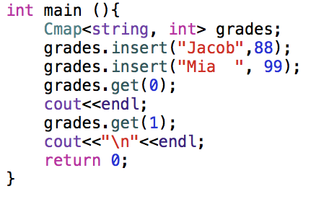
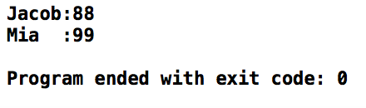

Slide 38
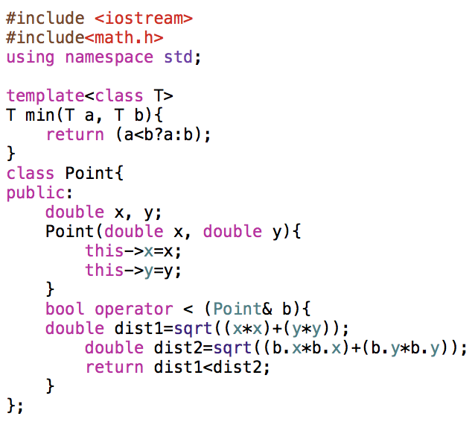
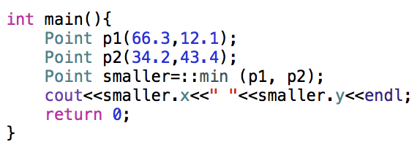


Point example
Notes:
if you have a constructor (or member function) that has a parameter with the same name as a member variable, you can disambiguate them by using “this”:
Note that our constructor is taking a parameter of the same name as a member variable. In this case, “data” refers to the parameter, and “this->data” refers to the member variable.

Slide 39
Templates specilazation
Template specialization lets templates deal with special cases.
Sometimes a generic algorithm can work much more efficiently for a certain kind of sequence , and so it makes sense to specialize it for that case while using the slower but more generic approach for all other cases.
Performance is a common reason to specialize, but it's not the only one; for example, you might also specialize a template to work with certain objects that don't conform to the normal interface expected by the generic template.

Slide 40
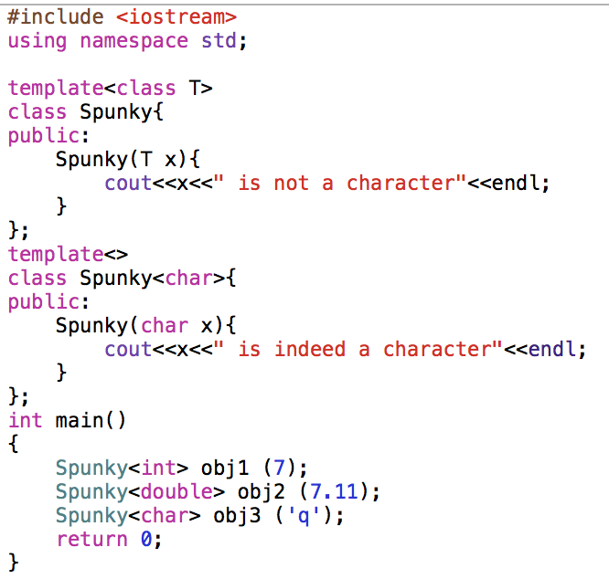
Need to specialize in whatever data type you want

